Slide 1
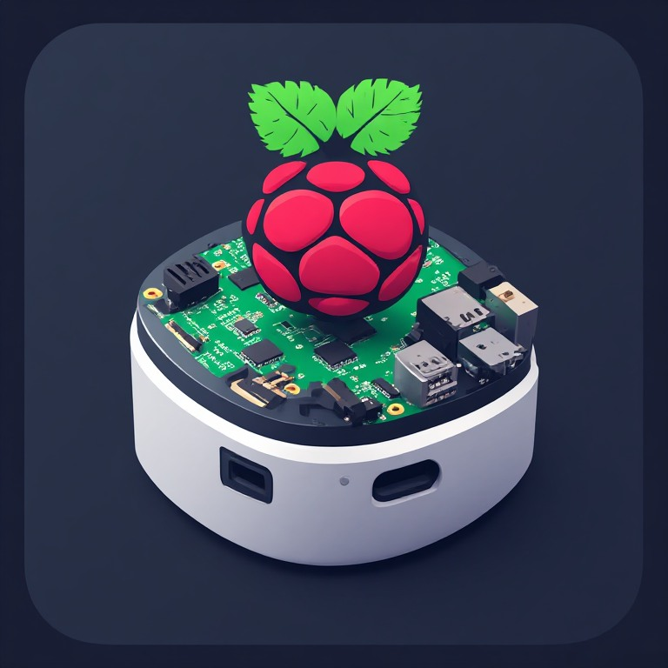

Sparky — Humanoid Home Assistant
A voice-first AI assistant that doesn't just answer — it acts.
Built on a Raspberry Pi Zero W with microphone, Bluetooth speaker, AI/LLM backends, and an optional phone/browser interface. Sparky transforms the smart home assistant from a command executor into a true personal AI agent.

Slide 2
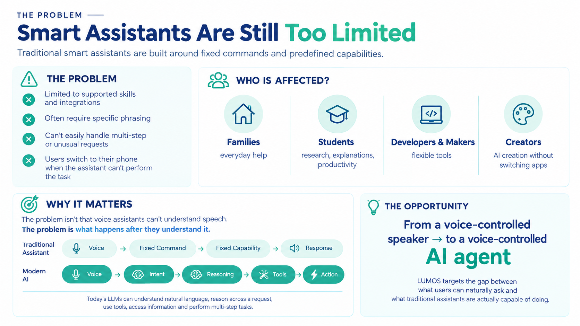
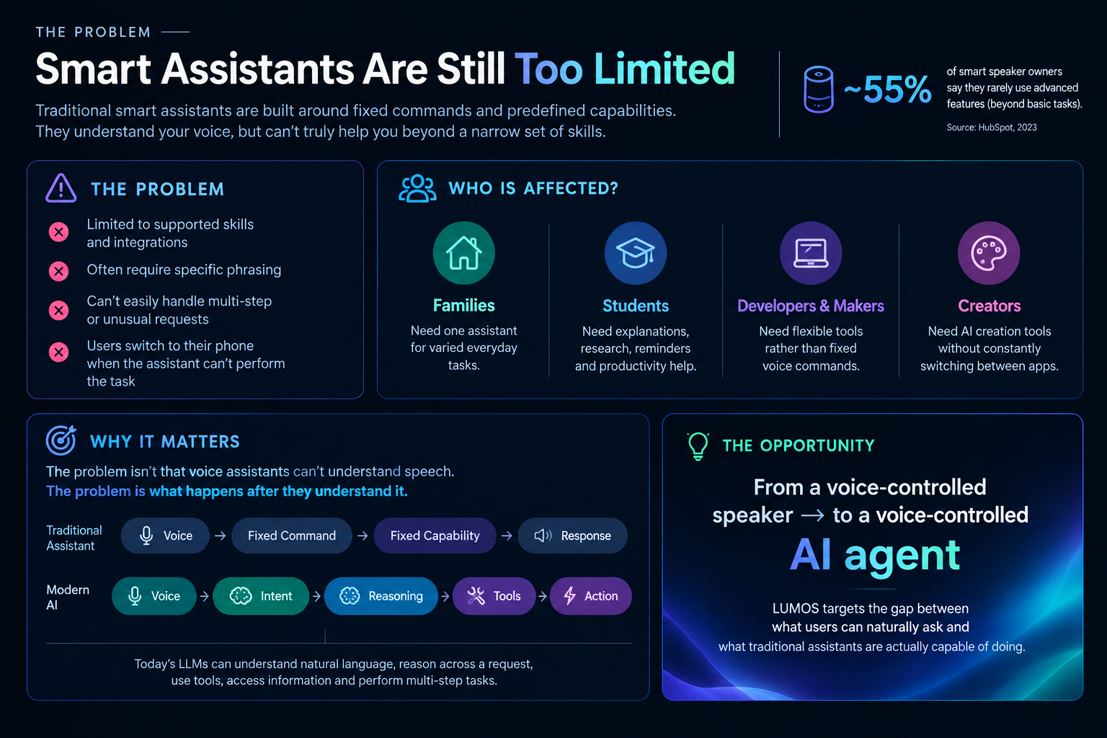
Smart Assistants Are Still Too Limited
Traditional smart assistants made voice interaction mainstream but the experience is still locked to predefined capabilities, skills, and a manufacturer's ecosystem. You can ask "Set a timer" or "Play music," but when the request gets complicated, users reach for their phone.
Problem:
Restricted to supported skills and integrations
Many tasks require specific commands or services
Users must often phrase requests in ways the assistant understands
Traditional Assistant
USER → FIXED COMMAND → FIXED CAPABILITY → RESPONSE
Modern AI
USER → NATURAL INTENT → REASONING → TOOLS → ACTION
The real opportunity
Today's LLMs can understand natural language, reason across a request, use tools, access information, and perform multi-step tasks.

Slide 3
Alexa Sparky
Alexa
Sparky
Not a true LLM-first assistant
Limited to Amazon’s ecosystem
Limited personalization
System prompt cannot be changed
Limited conversation
ChatGPT API
User flexibility through open source
Multipurpose approach through tools
Backup of previous conversation
Long distance conversation through IoT

Slide 4
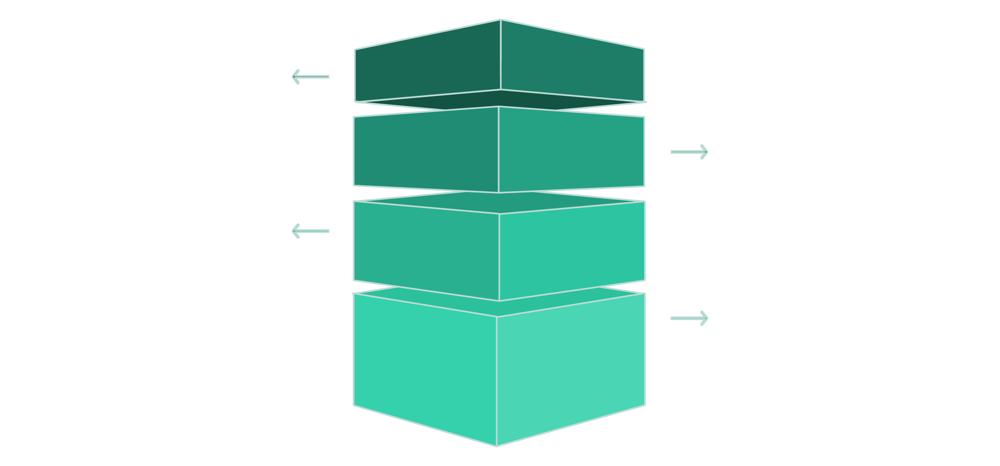
Meet Sparky
Sparky is a Raspberry Pi-based AI home assistant designed to listen, understand, act, and respond. One small device, one natural interface, many AI capabilities.
Listen Using Whisper
Demo Flow
User speaks to Sparky in normal language.
“Sparky, remember my project deadline."
Select & Execute
LLM chooses and runs the required tool or action.
→ Understands the request
→ Uses the memory system
→ Stores the information
→ Confirms through voice
Recognize & Route
AI transcribes and routes request to the TTS LLM.
Speak Result
Sparky vocalizes the outcome back to the user.
This single interaction demonstrates the core idea: natural language → AI reasoning → tool execution → response.
Sparky already handles: questions and conversation, web-aware information, music, reminders, persistent memory, image generation, AI music generation, Python execution, file management, GitHub operations, YouTube, HTML hosting, and automated multi-step tasks. It uses its set of tools to achieve what is already possible, like asking for an image of a cat, Sparky does not have access to cat images, but it can make an API request using one of the tools to get the image.

Slide 5
An AI Brain Inside a Small Home Device
Sparky’s architecture is built in four interconnected layers, each supporting multiple providers, keeping the system flexible and future-proof.
Speech Recognition
LLM Layer
Google Speech Recognition and Whisper python library accurate voice input from any distance.
OpenRouter and Google Gemini for web-aware AI model-flexible architecture, not locked to one provider.
Text-to-Speech
Tool Layer
Cartesia natural, expressive voice output for every response in a melodious voice.
Music, memory, reminders, files, Python, GitHub, YouTube, image generation, web services, HTML hosting Tools to allow Sparky to achieve goals that aren’t possible normally.

Slide 6
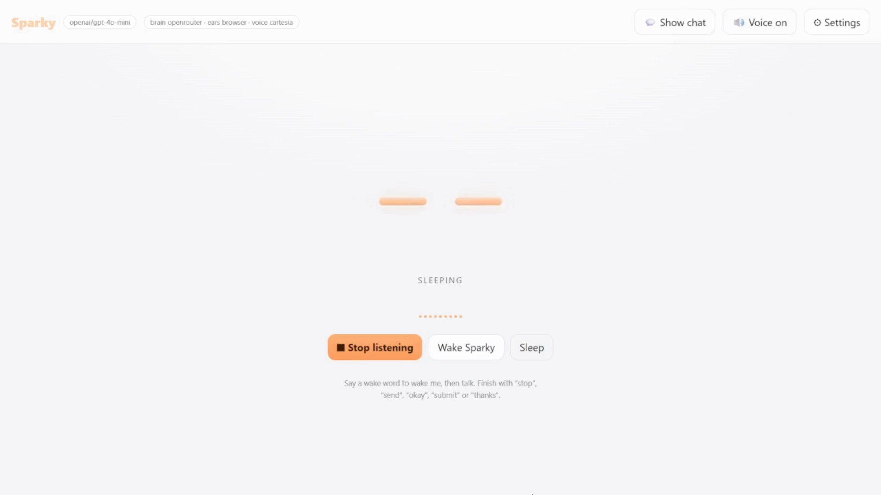
Sparky Is Already More Than a Concept
Sparky can play any song you tell it to (Using music API), It can get time, send notifications on E-mail or Discord, It can make playlists, control music, set reminders, remember things etc .ONLY in HTML. The real sparky hardware version runs python, to get maximum features.
It executes command using JSON, which the code then runs. These are called tools and can be merged, like playing a happy birthday song at 12:00 can be achieved by set reminder tool and play song tool. This is what Alexa and other Assistants cannot do.
Working Demo In HTML
(https://sparkyaiatal.pages.dev/)

Slide 7


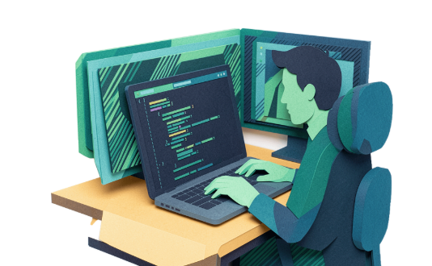
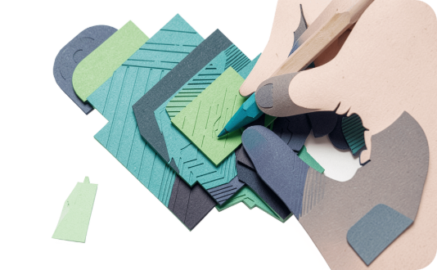
Who Is Sparky For?
Sparky serves a wide range of users, from families needing everyday help to developers automating complex workflows. The common thread: natural voice interaction that actually gets things done.
🏠 Families
🎓 Students
💻 Developers & Makers
🎨 Creators
“Sparky, remind me to call Dad at 8." Reminders, information, music, and everyday assistance for the whole household.
“Sparky, explain this concept." Research, questions, reminders, coding help, and productivity support.
“Sparky, generate an image for my project." Image generation, AI music, and content creation on demand.
“Sparky clone this GitHub repository." GitHub, files, Python, and development workflows — hands-free.

Slide 8

Turning a Smart Speaker Into a Personal AI System
1
Device
One Raspberry Pi replaces multiple apps and screens for supported tasks.
10+
Tool Categories
Music, memory, files, GitHub, Python, web, YouTube, images, automation, and more.
3
AI Backends
OpenRouter, Groq, and FreeAI — switch models without changing hardware.
0
Ecosystem Lock-in
Built from open software components that can be changed and extended.
Sparky moves the smart-home experience from Command → Response toward Intent → Reasoning → Action. Productivity improves because users describe tasks naturally. Accessibility increases through voice-first interaction. And the platform evolves — new AI models, tools, and integrations — without redesigning the physical product.

Slide 9



Possible Business model:
Sparky’s roadmap is structured in three clear phases, each building on the last — from a working prototype to a full personal AI platform.
Phase 1 — Development
Phase 2 — Product
Phase 3 — Platform
Raspberry Pi + microphone + Bluetooth speaker. Goal: reliable voice interaction and core AI capabilities and testing.
Custom enclosure, improved microphone, better audio, simplified setup. Goal: make Sparky usable as an everyday home device.
Smart-home integrations, sensors, local AI, user profiles, custom automations, and a developer tool ecosystem.
Possible Business Model
Scalability
Hardware: Sell an affordable Sparky device
Software: Optional premium AI/model features
Integrations: Home automation and specialized deployments
Developer Platform: Users create and add their own Sparky tools
Sparky’s architecture scales through software, more models, more tools, more APIs, more devices, and eventually full smart-home automation. The same software concept can move to more powerful Raspberry Pi hardware or custom hardware over time.

Slide 10
Technical feasibility, and risks:
Requirements:
Risks
To build Sparky, We would need a SBC, LLM API, TTS API, Songs API, Mic, Speaker, Amplifier, Power Supply, Screens etc.
Mic not picking up the audio, LLM providers failing, TTS API down. This can be solved by building our own servers, which can be hard and is not possible at early stages.
Breach Potential
Future Enhancements
Different outcomes as compared expectations, Technical Glitch
New tools, OTA Updates, Software updates support, Developer platform, new voices, new AI models, new hardware, better microphones.

Slide 11
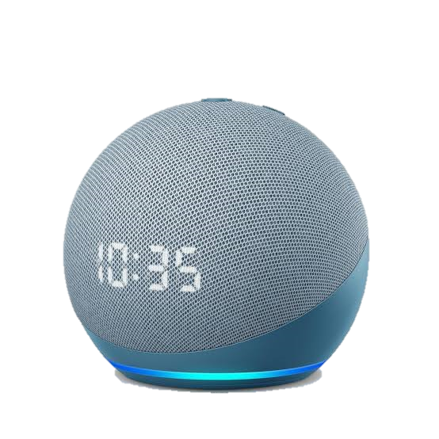
What makes us Unique from already existing solutions like Alexa:
We use newer AI models, that are compatible with reasoning. Alexa is still stuck on old software and AI. Sparky combines tools to achieve goals, Alexa follows a fixed pattern.
Sparky is aware and updates its memory regularly. Alexa and Google Assistant doesn’t.
Assistants like Sparky are the future. It can be integrated with smart home, local homelabs, wifi lights and fans, cameras, personal reminders and routines and MUCH more.

Slide 12
Backbone of Sparky
Team Roles
Mentor
Arnav Bansal : Project Idea and working
Chirag Jain : Hardware and Presentations
Kanish Jain : Editor and Helping Hand
Maulik Patolia,
the one who guided and enlightened us throughout this project.
Contact Details
Future vision
Email ID : maulikpatolia007@gmail.com
chirag.vijendra944@gmail.com
GitHub:
Id : @cyborgchirag
The aim of Nox is just to create AI models which can integrate sustainability, and user comfort. In this revolutionizing world of technology, Nox tries that every problem has an innovative and pocket friendly solution. Sparky is the first step towards it.

